Slide 1


AdventureWorks
Team 5

Slide 2
Introduction
Team members:
Bo Yang, Ziang Cui, Ang Li, Xiaomeng Xu, Li Zhuang
Businesses of every team member
Bo Yang - Sales
Ziang Cui - Membership
Ang Li - Inventory
Xiaomeng Xu - Manufacturing
Li Zhuang - Purchasing
Dataset:
OLAP
71 tables -> 23 Tables -> 21+1 Tables
5 Shared Dim Table

Slide 3
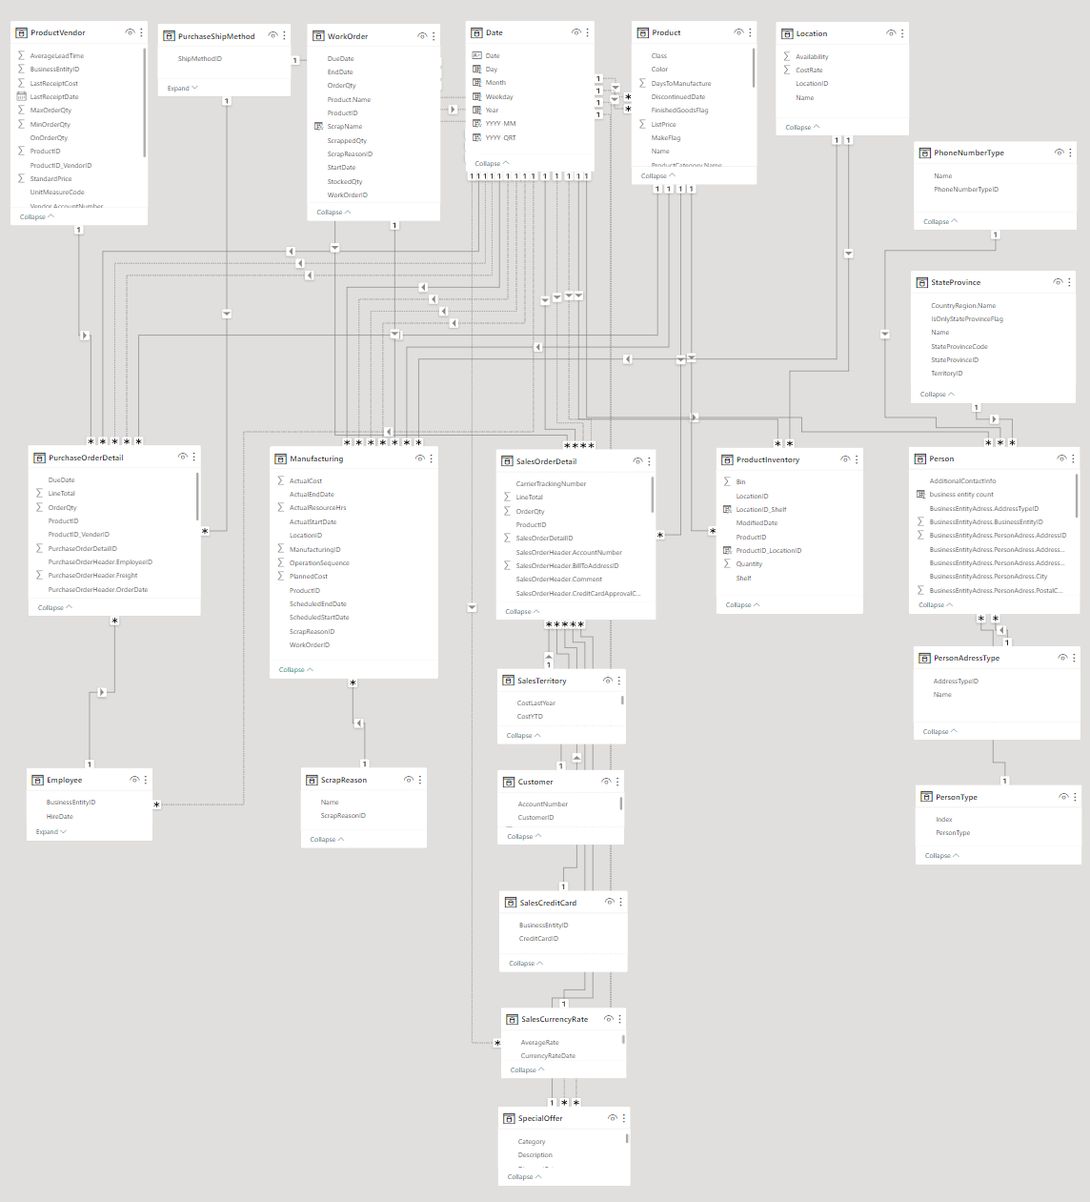
Fact Table

Slide 4
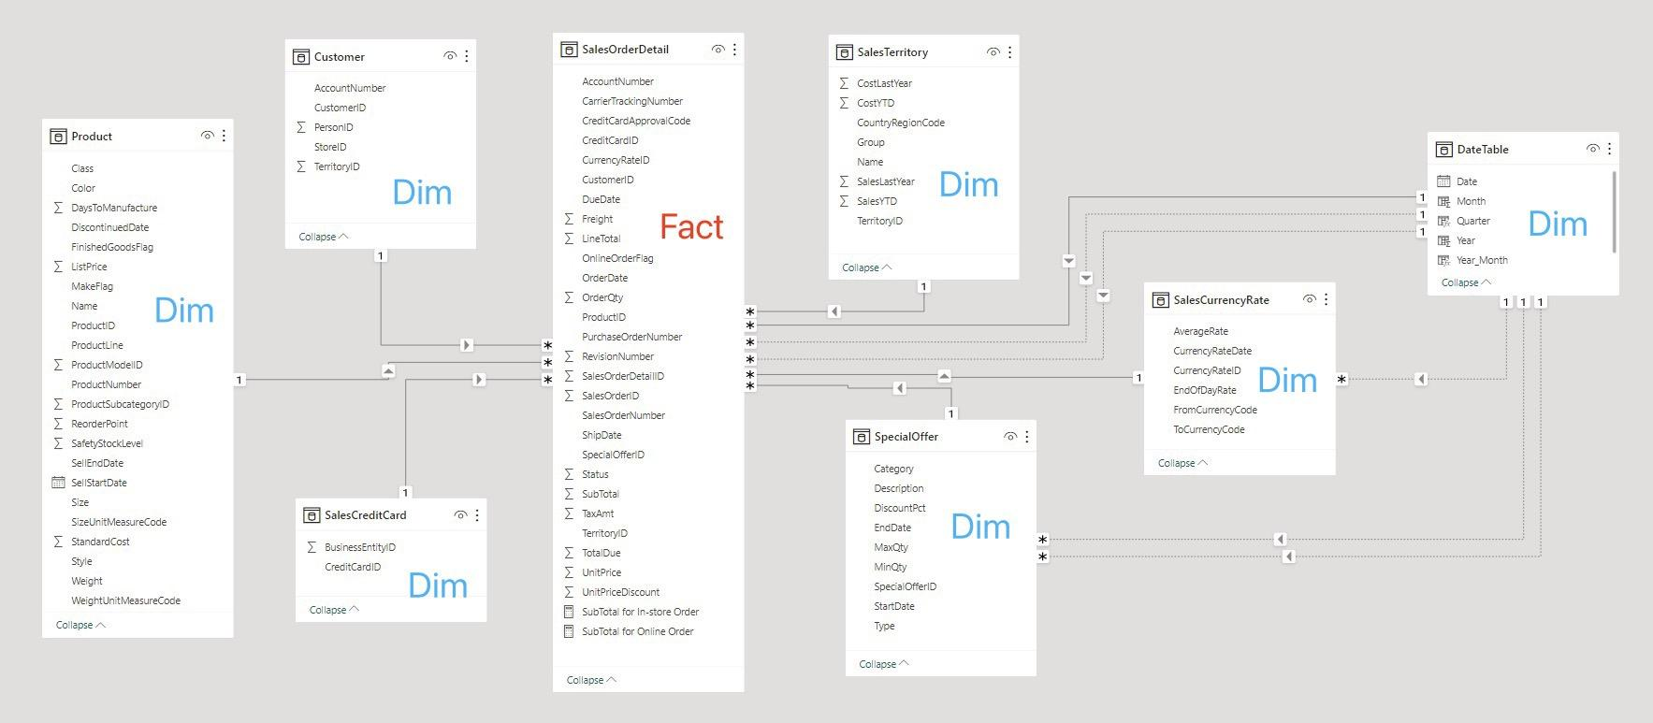
Data Model - Sales
Business process: Sales
Fact table:
SalesOrderDetail
Dimension table:
Product
Customer
SalesCreditCard
SalesTerritory
SpecialOffer
SalesCurrencyRate
DateTable

Slide 5
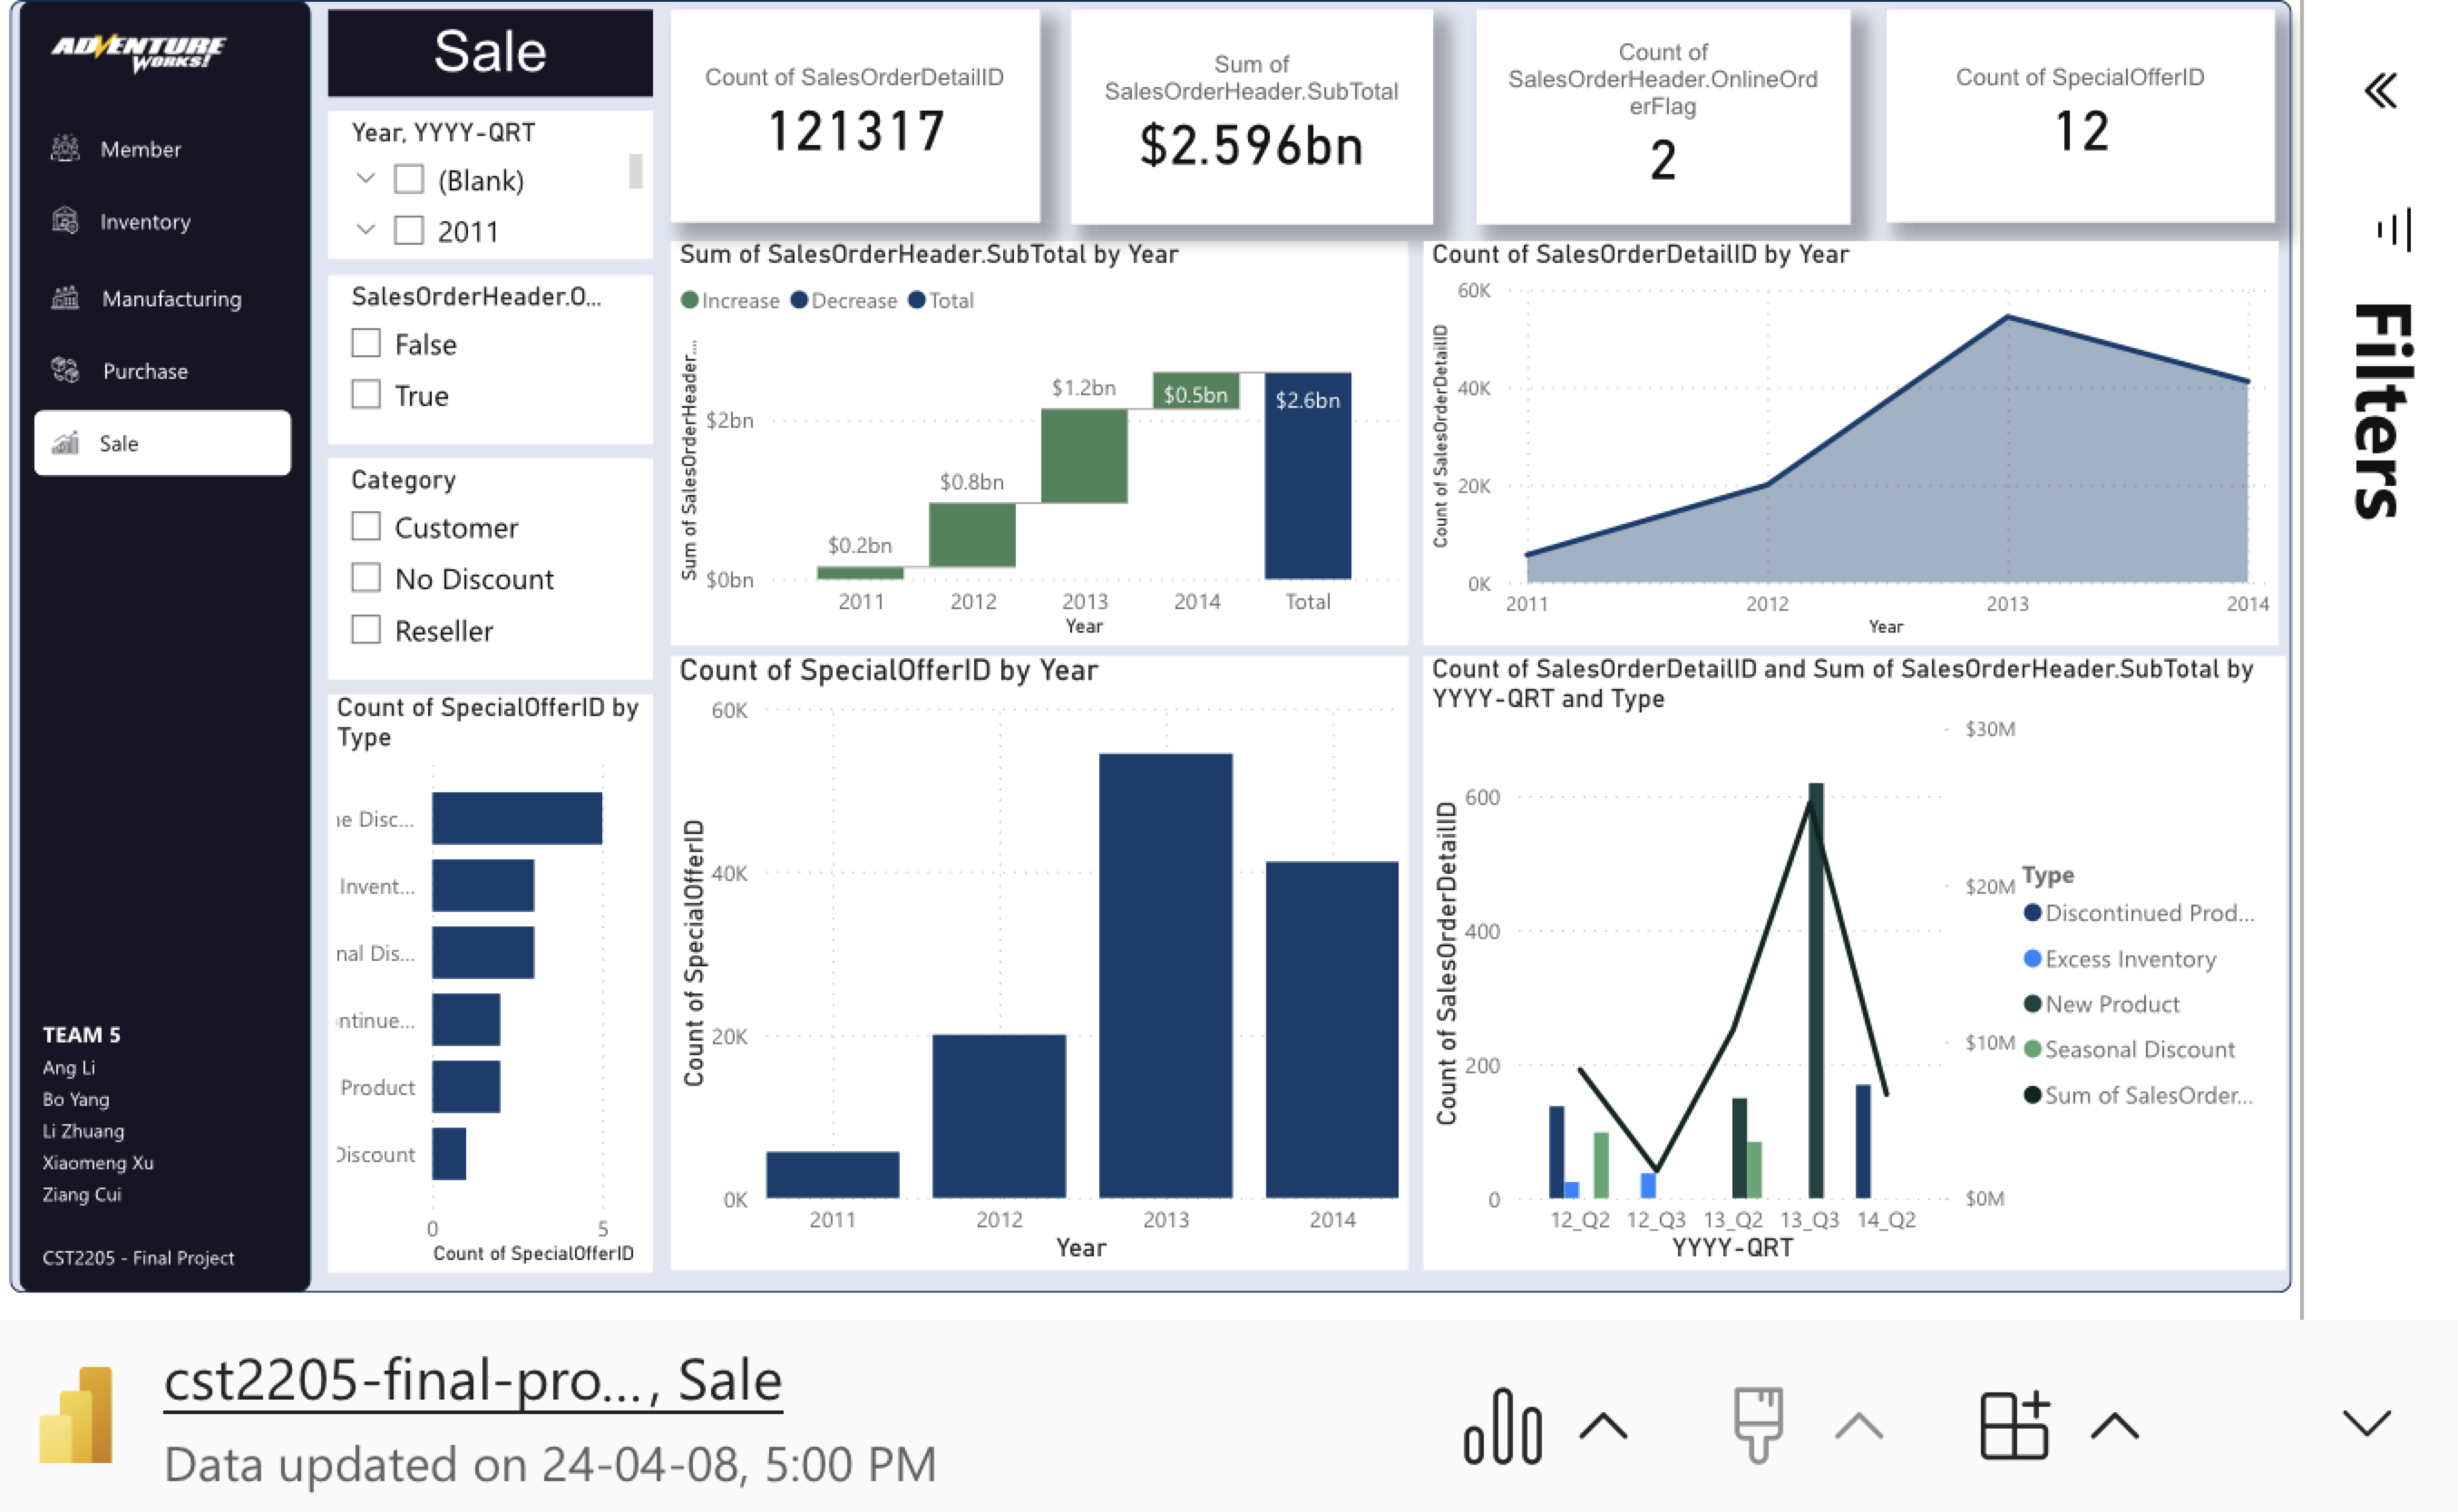
Visualization and Storytelling - Sale
key factor:
Order Type?
INSTORE
Special Order (Discount)?
NEW PRODUCT
Recommendations:
Discount strategy
Product launch strategy

Slide 6
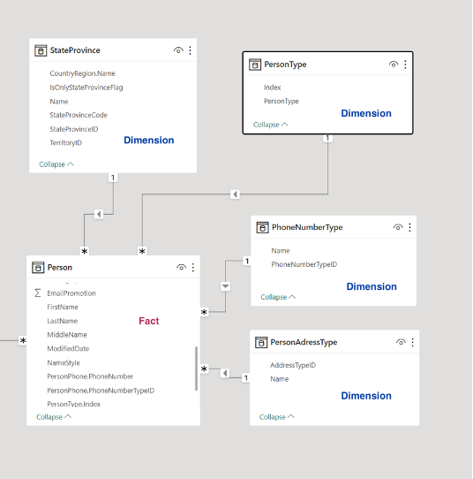
Data Model - Membership
Business process:
Fact table: Person
Dimension table: StateProvince, PersonType, PhoneNumberType, PersonAddressType

Slide 7
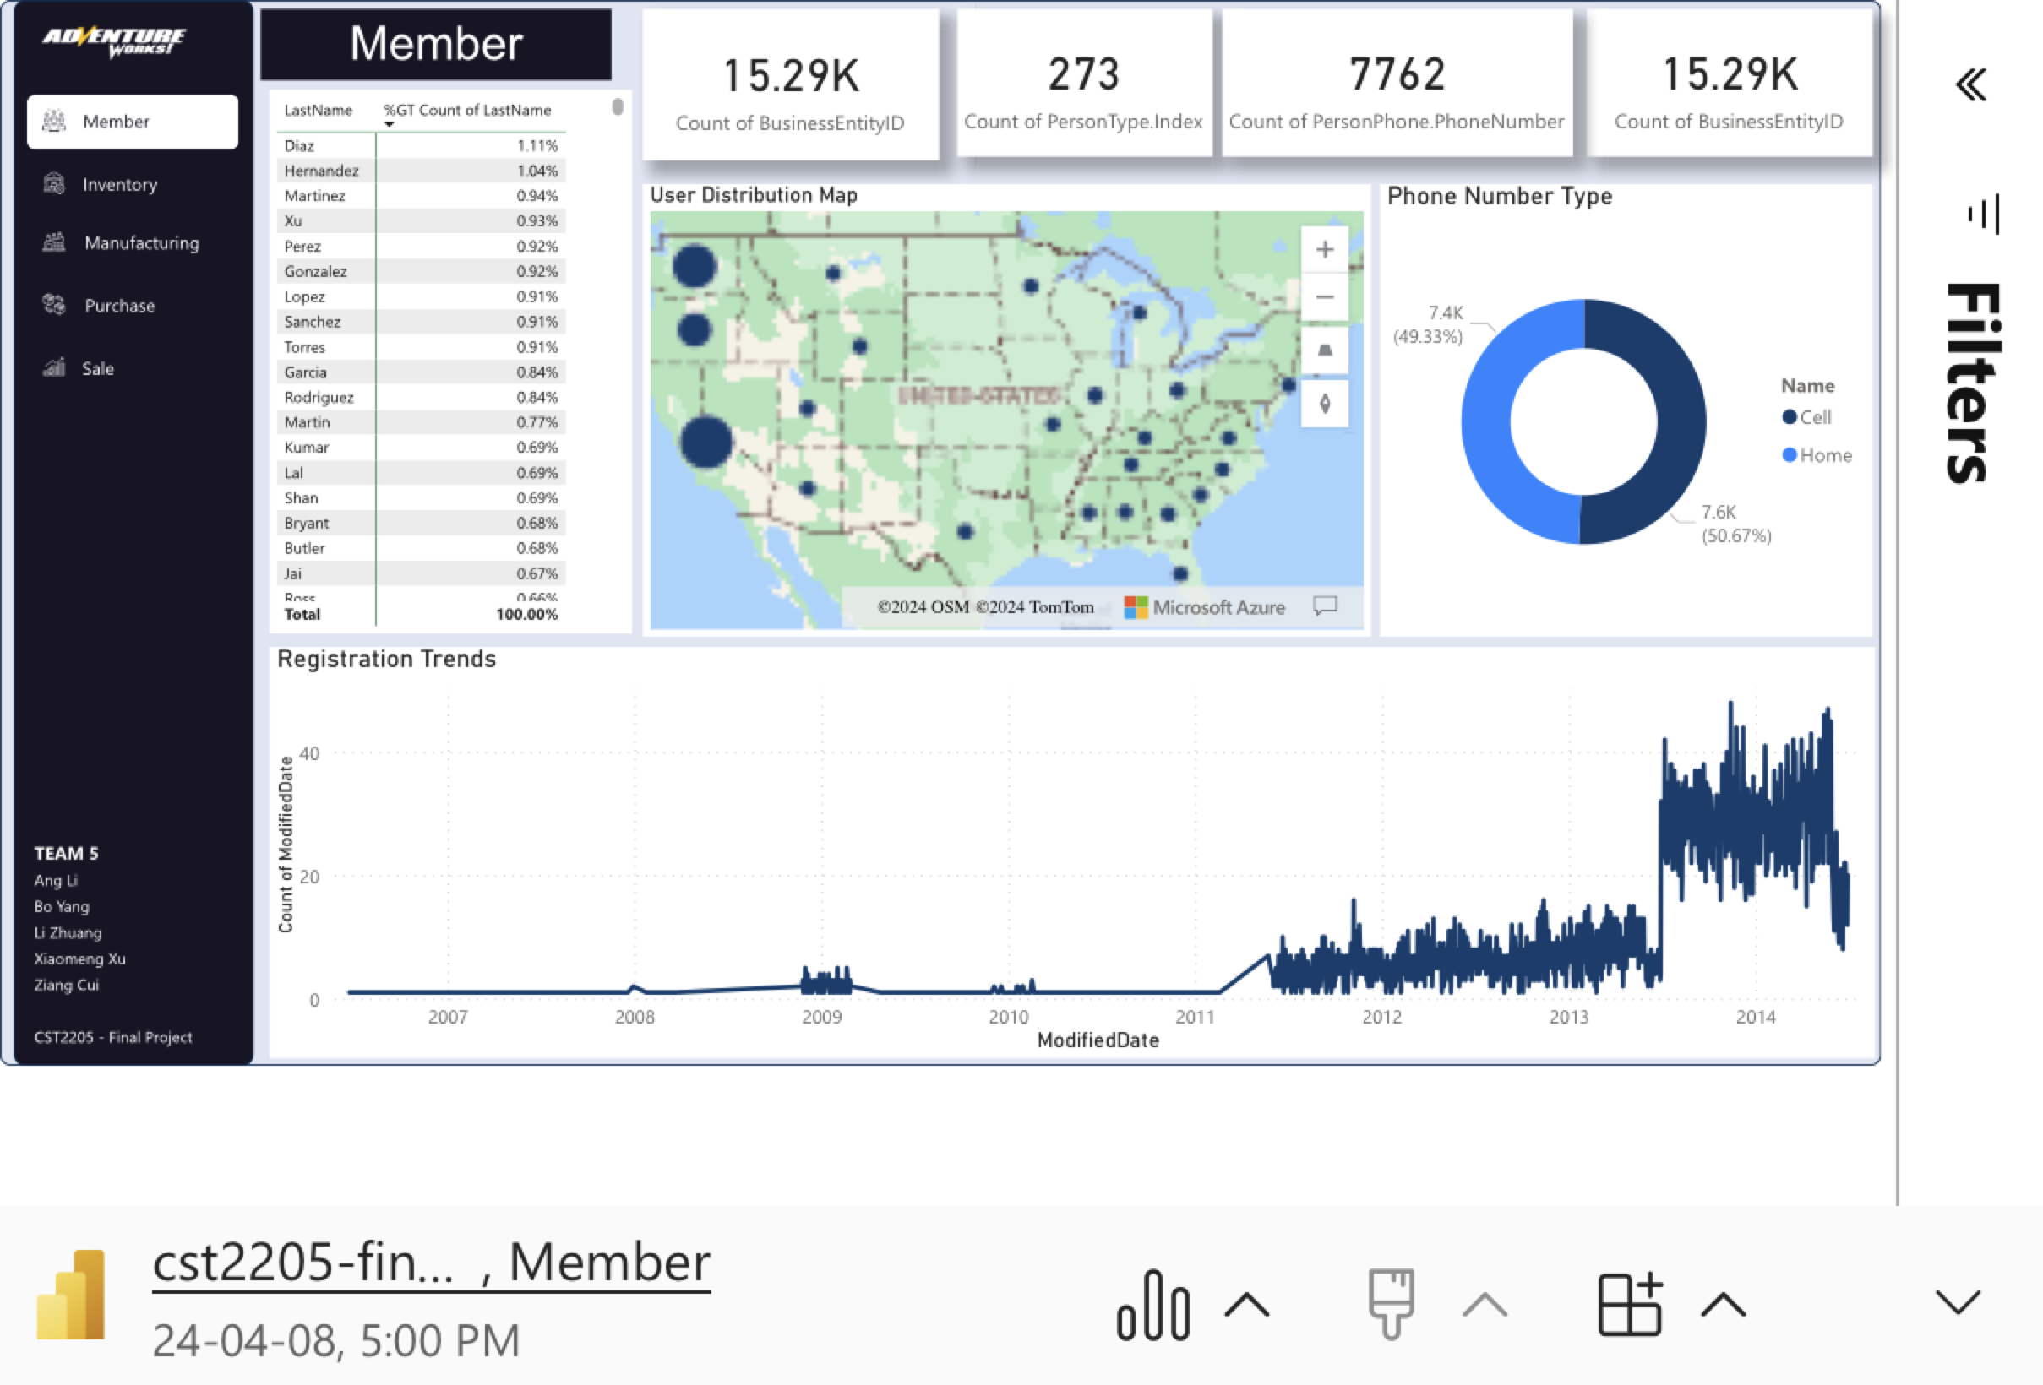
Visualization and Storytelling - Membership
Basic Information:
Person and its related information
Insights:
Most U.S. and Canadian users are on the West Coast
No significant difference in the number of cell phones and home phones
There was a significant boost in between 2013 and 2014.
European descent the most, then Asians.

Slide 8
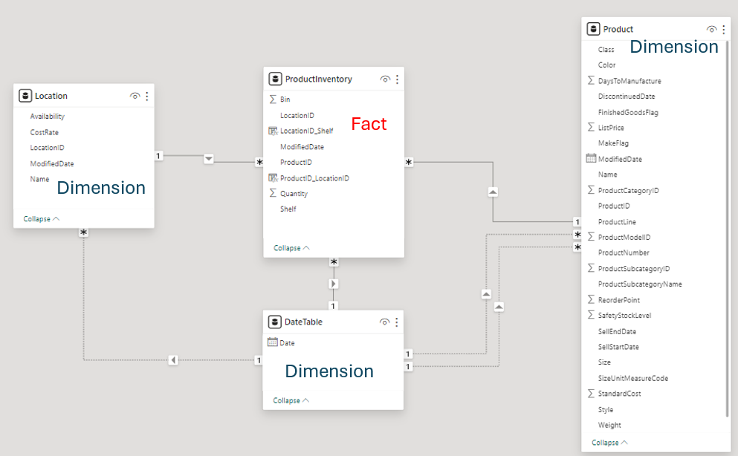
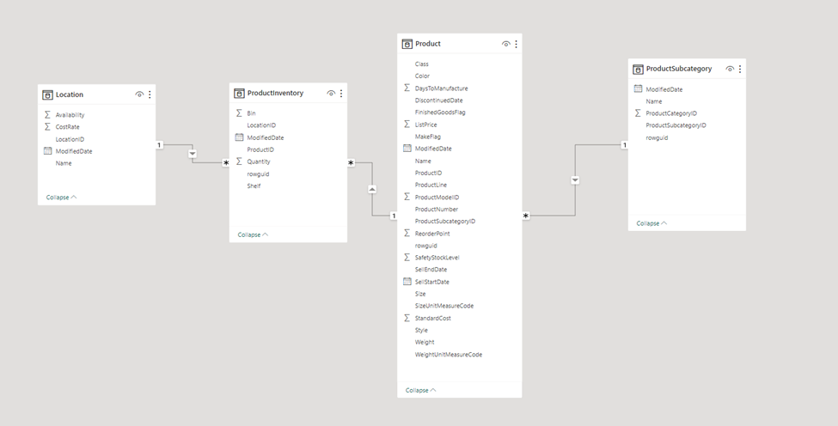
Data Model - Inventory
Business process:
The locations where these products are stored.
Star Schema Build up
Fact table: ProductInventory
Dimension table: Location, Product, DateTable

Slide 9
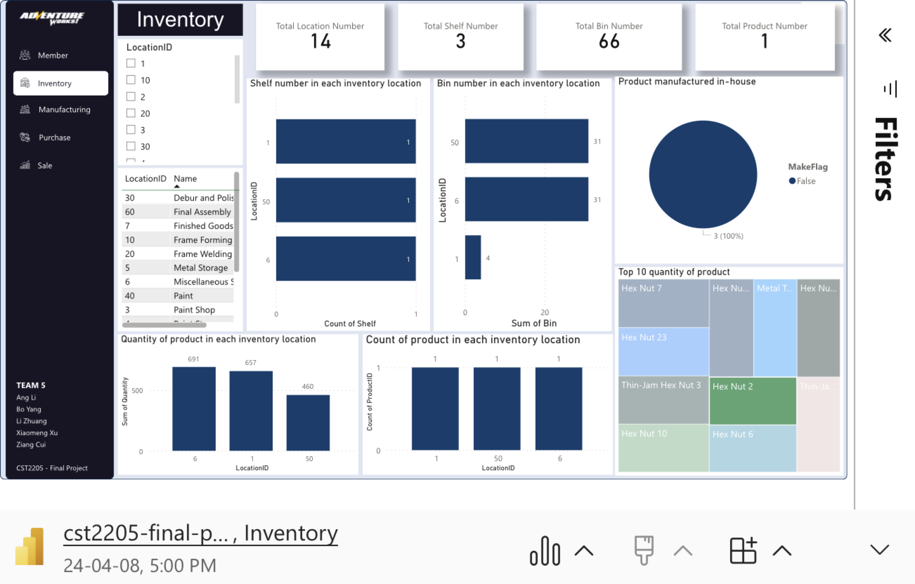
Visualization and Storytelling - Inventory
Basic Information:
Total Location Number
Total Shelf Number
Total Bin Number
Total Product Number
In each location:
Shelf number, Bin number, Quantity of product, Count of product
Insights:
Top 10 quantity of product all stored in Location 1, 6, 50
Location 1, 6, 50 are the top 3 locations with the most shelves, bins, quantity of product, and count of product

Slide 10
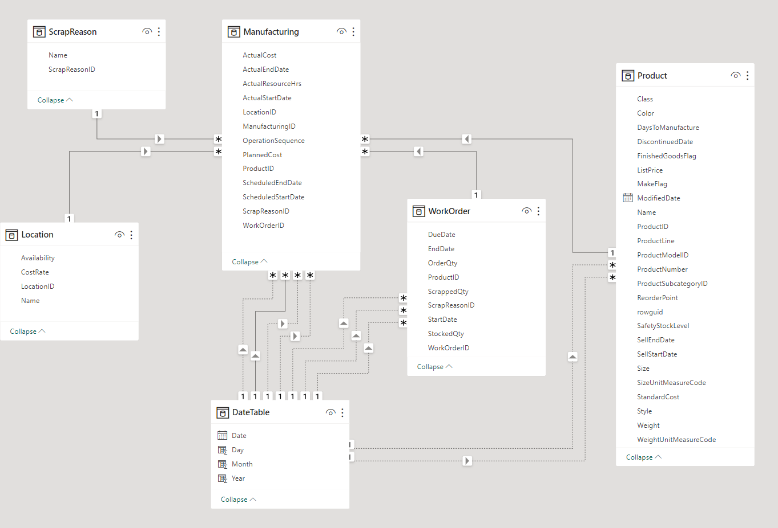
Data Model - Manufacturing
Business process:
Manufacturing.
Our company places the work orders and our factory receives the work orders and do their job to manufacture products and track scrapped materials.
Fact table:
Manufacturing
Dimension table:
ScrapReason
Location (confirmed)
Date (confirmed)
WorkOrder
Product (confirmed)
Relationships: many to one

Slide 11
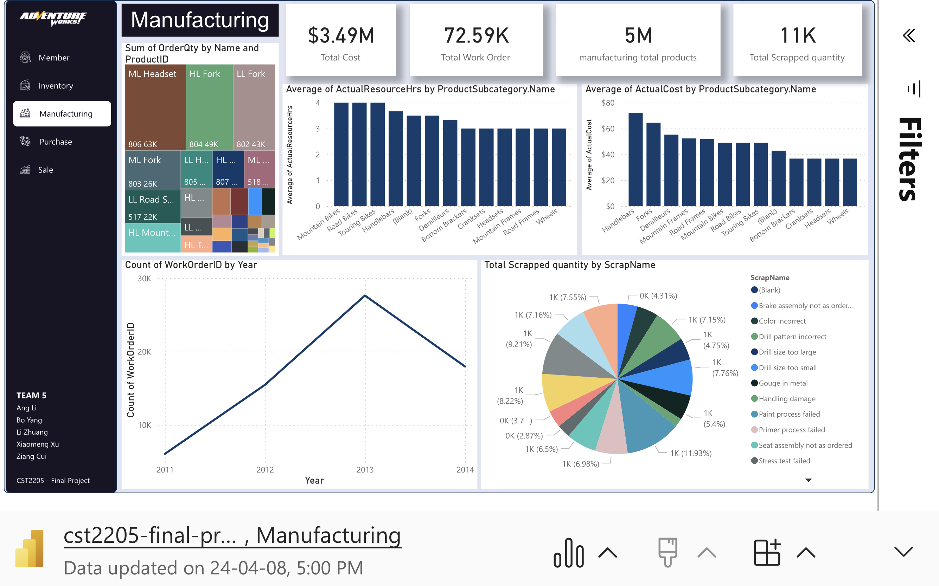
Visualization and Storytelling - Manufacturing
Time period of the statistics
Key performance indicator
The top three products we manufactured by order quantity
The scrapped rate = 11K / 5 M =0.024%
Improve:
Paint process failed
Trim length too long

Slide 12
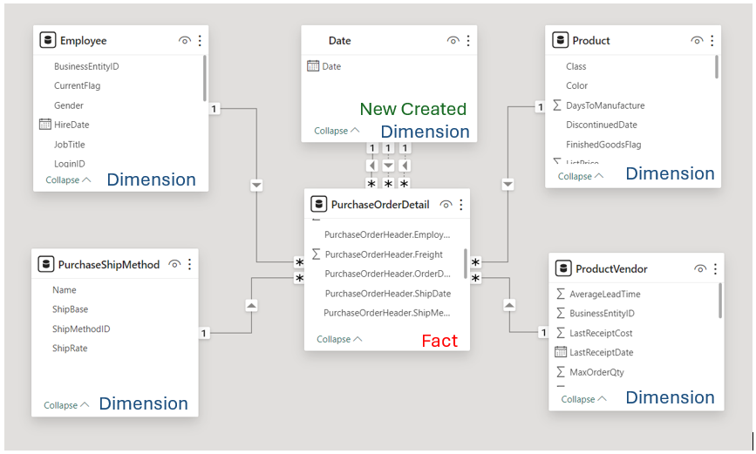
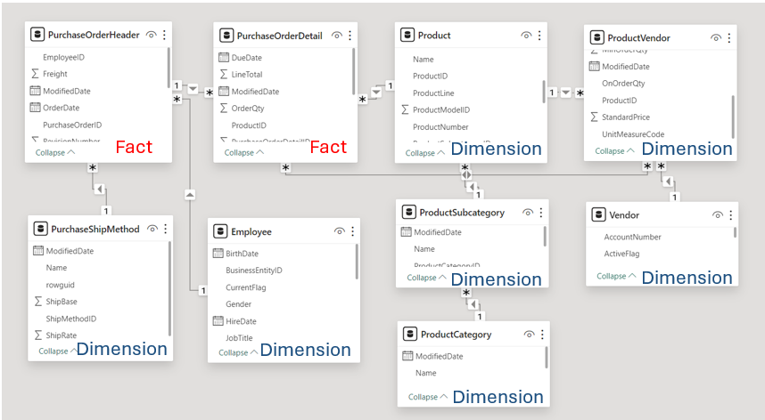
Data Model - Purchase
Business process:
A purchase order detail from creation to delivery, including product, quantities, finances, status, key personnel, and vendor etc.
Fact table:
2 tables ->1 table
Dimension table:
7 tables -> 4 tables
Add a Date table as date dimension
Before Data Modeling
After Data Modeling

Slide 13
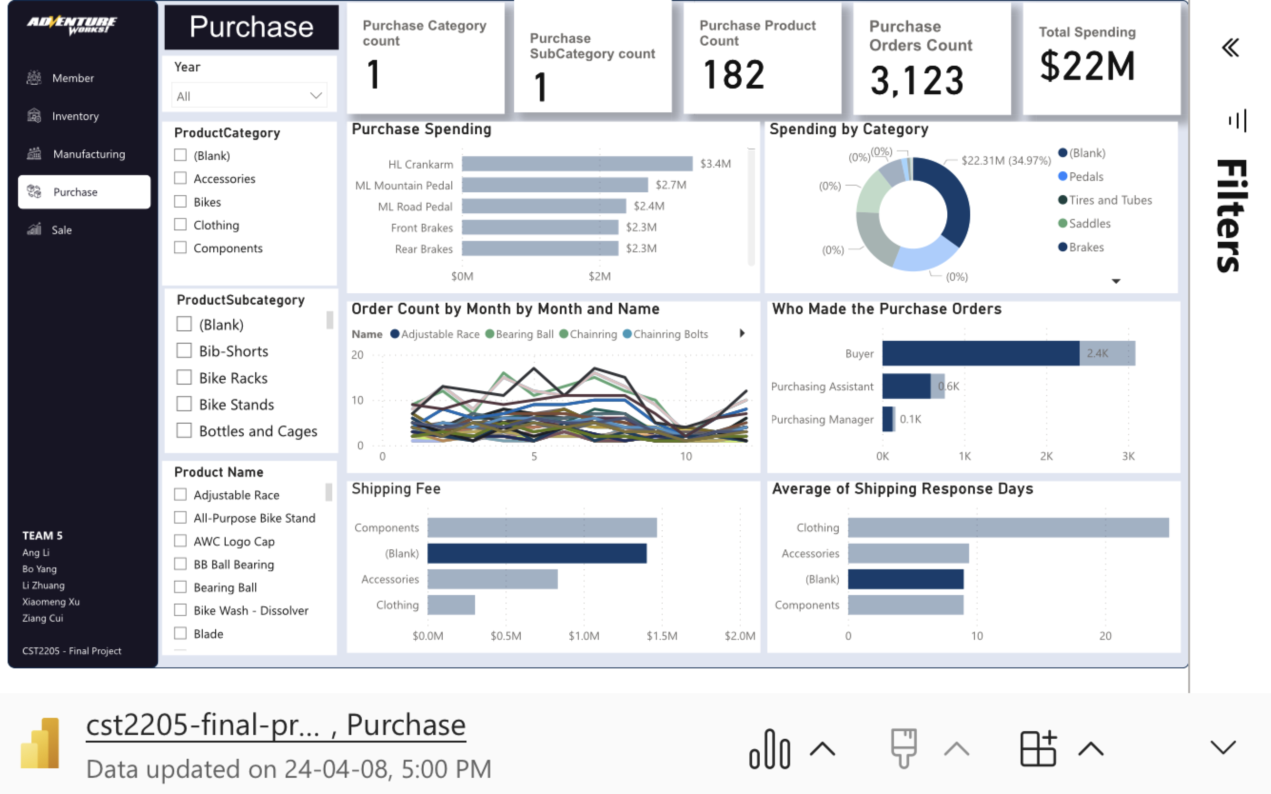
Visualization and Storytelling - Purchase
4 Categories (not including bikes)
Purchase goes two Lines, Sales and Manufacturing
No category products spent more than $22M
The procurement for the production line accounts for 2/3 of the freight cost

Slide 14
THANKS

Slide 15
Q1：Multiple Choice Question
According to this data model, which tables do we need to join to query the total sales quantity of a specific product at a particular location?
A. 'SalesOrderDetail', and 'Location'
B. 'Product', 'SalesOrderHeader', and 'Location'
C. 'Product', 'SalesOrderDetail', and 'Location'
Answer：C

Slide 16
Q2：True or False
In a relational database model, a many-to-many relationship between two entities can always be directly represented without the need for a junction table.
- True
- False
Answer：False
Explanation: In a relational database model, a many-to-many relationship between two entities requires a junction table to properly represent the relationship. This junction table resolves the many-to-many relationship into two one-to-many relationships, linking the primary keys of the two related tables in the junction table.

Slide 17
Q3：True or False
A composite key in a database table consists of multiple attributes that individually serve as primary keys in other tables.
- True
- False
Answer：True
Explanation: A composite key in a database table is a key that consists of two or more attributes (columns) that uniquely identify a row in the table. These attributes can individually serve as primary keys in other tables, and when combined in a composite key, they ensure the uniqueness of each row in the table where the composite key is defined.

